Slide 1

11th July 2024 Clémence Grocholska
Fraud Detection in Mobile Money

Slide 2
Fraud Detection and Synthetic Data by PaySim
Fraud detection research in financial services, especially mobile money, faces a data gap due to the privacy of financial transactions. The PaySim simulator addresses this by creating synthetic datasets that mimic real-world mobile money transactions. It uses aggregated data from private sources to simulate regular activity and inject fraudulent behaviour, allowing researchers to test fraud detection methods without risking sensitive information.
PaySim is based on a sample of real mobile money transactions from an African country, provided by a multinational company with services in over 14 countries. This synthetic approach provides a valuable resource for advancing fraud detection research. Synthetic Financial Datasets For Fraud Detection (kaggle.com)
The dataset at the heart of our project is a carefully curated collection of data, derived from a month’s worth of financial logs from a mobile money service operating in an African country. This dataset represents a scaled-down version (1/4th of the original size) with variables:
type: The type of transaction. The possible types are CASH-IN, CASH-OUT, DEBIT, PAYMENT, and TRANSFER.
amount: The transaction amount in local currency.
nameOrig: The customer who initiated the transaction.
oldbalanceOrg: The initial balance of the customer before the transaction.
newbalanceOrig: The new balance of the customer after the transaction.
nameDest: The recipient of the transaction.
oldbalanceDest: The initial balance of the recipient before the transaction. There is no information for customers whose names start with "M" (indicating merchants).
newbalanceDest: The new balance of the recipient after the transaction. As with "oldbalanceDest," there is no information for customers whose names start with "M."
isFraud: Indicates whether a transaction is fraudulent.
Notes:
Analyzing Financial Transactions (kaggle.com)
Unveiling the Veil of Fraud: A Deep Dive into PaySim’s Synthetic Financial Data | by Bindu Raghu Naga | Medium
Function:
Cash-In: This refers to the process of depositing cash into an account. This could be done at a bank branch, ATM, or other designated location.
Cash-Out: The opposite of Cash-In, this refers to withdrawing cash from an account. This is typically done at an ATM or a bank branch.
Debit: This signifies using your debit card to pay for something. When you use a debit card, the funds are deducted directly from your linked checking or savings account.
Payment: This is a broader term encompassing any method of settling a financial obligation. It can involve cash, debit card, credit card, check, money order, online payment system, etc.
Transfer: This refers to moving money from one account to another. This could be between your own accounts (e.g., checking to savings) or to someone else's account. Transfers can be done electronically, by check, or even through wire transfer services.

Slide 3
AGENDA
Overview on the weight and amount of fraudulent transactions
Choice of target
Categorical variables
Numeric transactions
Logistic regression and treatment of imbalanced data
Decision Tree and Random Forest
Conclusion and next steps

Slide 4

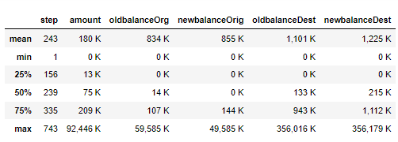
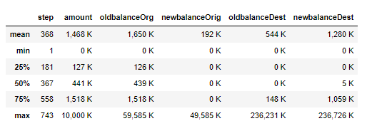
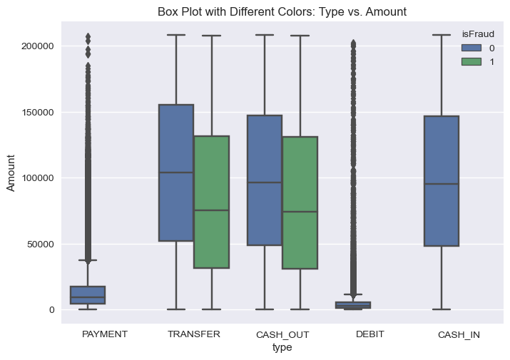
Overview on fraudulent transactions
During the Exploratory Data Analysis (EDA) phase, we notice a fraud rate of 0.12% out of 6,362,620 transactions.
The amount of a fraudulent transaction is different in scale compared to non-fraudulent transactions.
All transactions
Fraud transactions
Transactions below 208 000 without extreme values
To avoid the Simpson's paradox, it is recommended to analyse different transaction amount categories separately. Otherwise, the amount variable may dominate the model, preventing other important variables from being selected in predicting fraud.

Slide 5
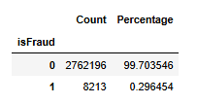
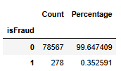
Choice of target
During the Exploratory Data Analysis (EDA) phase, we notice a fraud rate of 0.12% out of 6,362,620 transactions.
We build a new fraud indicators:
Fraud take place only on transfer and cash-out transactions and the population exclude therefore other types of transactions: new fraud rate is of 29.6%
We decide to start with small transactions of less than 10K to validate our methodology.
Note: With a 0.32% of fraud, imbalanced data will have to be tackled before running any model

Slide 6
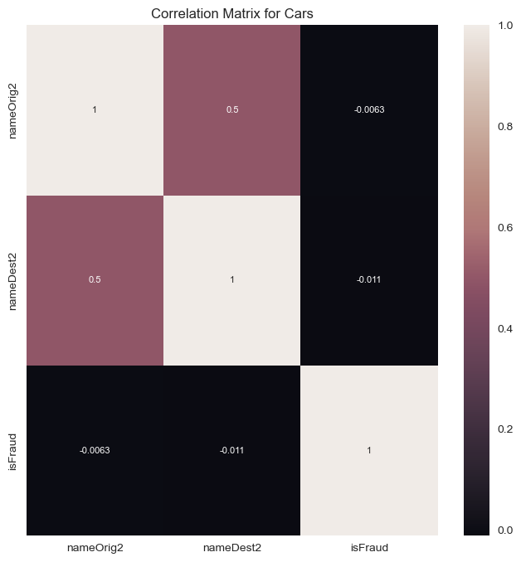
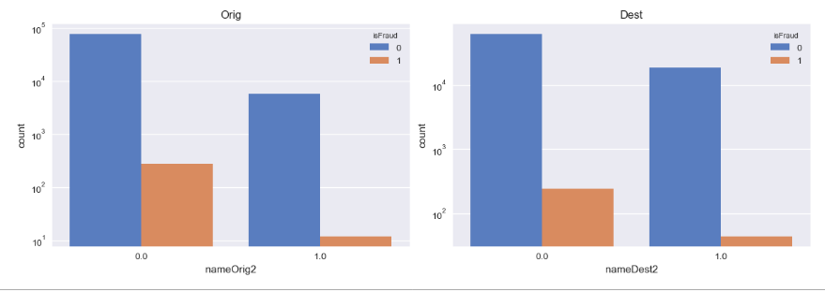
Categorical variables
Correlation matrix for the involvement of origin and destination accounts with fraud
With origin and destination account numbers, we can identify if accounts have been involved in multiple fraudulent transactions, either by being charged or by receiving money.
Volume of transactions
No
Yes
No
Yes
Origin account involved twice (nameOrig2)
Destination account involved twice (nameDest2)
We will add nameDest2 (Destination account involved twice) in our model while deleting nameOrig2 and the exact account numbers: A 0.5 correlation indicates a moderate positive relationship. While not very strong, it may suggest the feature explains some of the variance in the dependent variable.

Slide 7
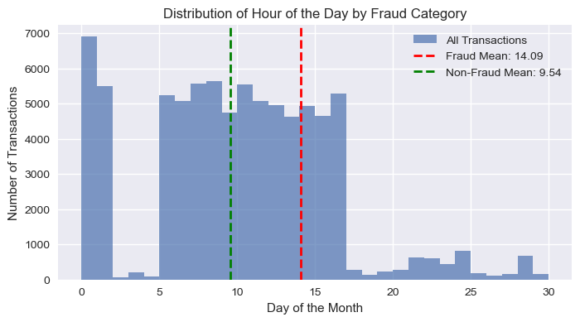
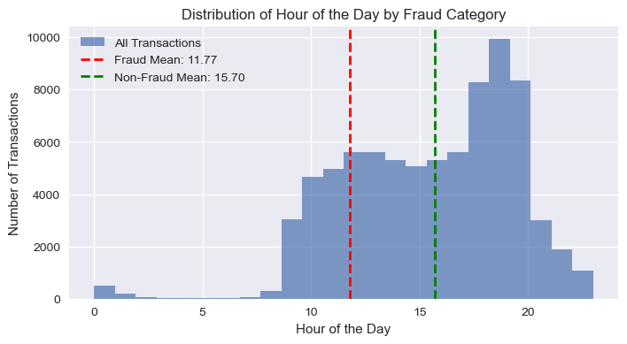
Numeric transactions 1/2
Variable step representing time
We transform the variable step to have a good overview of the influence of time on fraud:
Fraudulent transactions tend to occur later in the month on average and later in the day (around 3 PM instead of midday). They also tend to involve slightly smaller amounts. All criteria are put in place to try to make them unnoticed!

Slide 8
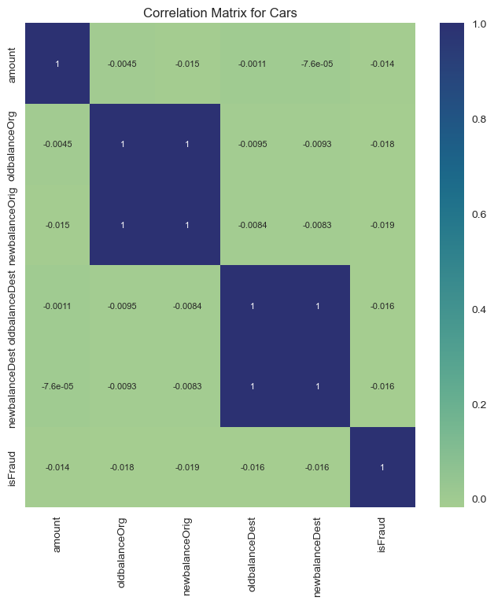
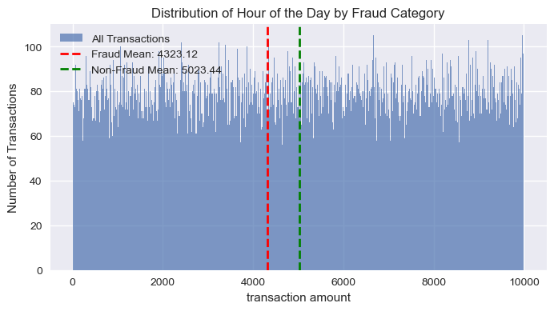
Numeric transactions 2/2
Amount of the transaction and on balances
Correlation matrix for numeric variables
On small transactions of less than 10K, fraudulent transactions are still of a lower amount in average:
We keep amount in our model even though it should be of little importance as we decided to focus on small transactions (low correlation).
Old and New balance origins as well as Old and New balance destinations are correlated. Only one of those metrics should be selected in each pair

Slide 9
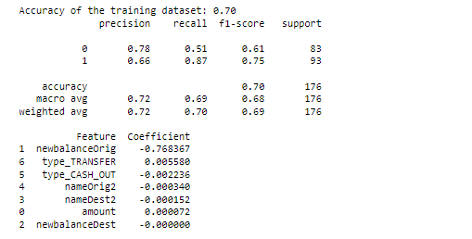
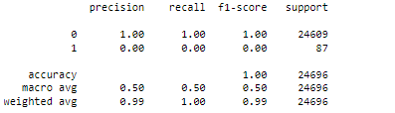
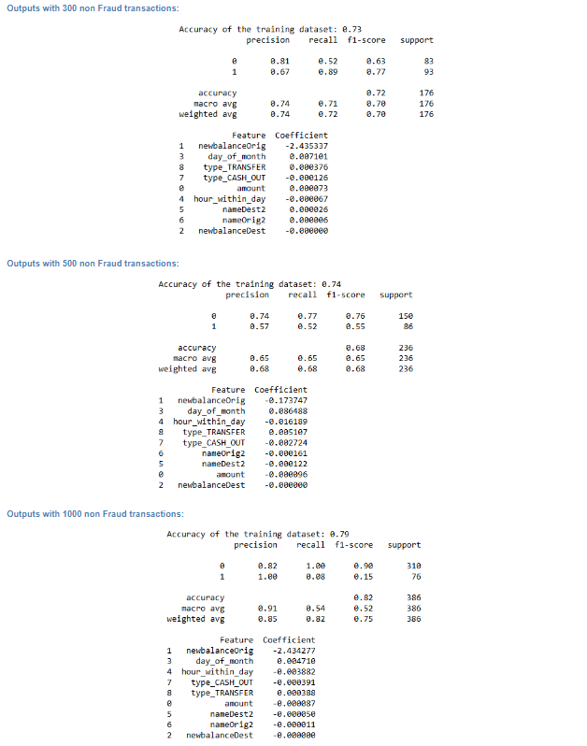
Logistic regression and treatment of imbalanced data
The results of running a logistic regression on the whole population are inconclusive even though the accuracy of the training dataset is 0.99:
Logistic regression on sampled non-fraud transactions
All 278 fraud / 300 sampled non-Fraud transactions
All 278 fraud / 500 sampled non-Fraud transactions
We chose the model with 300 sampled non fraud transactions as it has a good recall and f1-score. Another important point is that it takes into account more variables, there is less of an over-reliance on newbalanceOrig.
All 278 fraud / 1000 sampled non-Fraud transactions

Slide 10
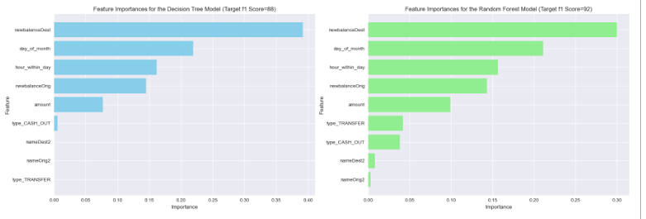
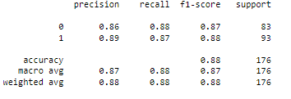
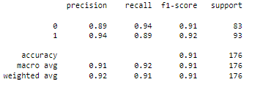
Decision Tree and Random Forest
We compare our model with a decision tree and random forest: The random forest is providing the best results considering the F1-score on fraud.

Slide 11
Conclusion and Next steps
To model fraudulent transactions, we:
Decided to work on a specific category of transaction amounts to ensure we would not simply model the amount itself.
Tested the best ways to handle imbalanced data by selecting the appropriate sample size using logistic regression.
Compared logistic regression with other models and concluded that the random forest is the best model.
For the next steps, we recommend:
Applying a random forest to other transaction amount categories while also
Separating out cash-outs and transfers
Compare models with XGBoost

